Slide 1
Module 5 Real Time Operating System

Slide 2
Embedded classification
Performance and Functional Requirements
Performance of Micro-controllers

Slide 3
Performance and Functional Requirements
Based on Performance and Functional Requirements it is divided into 4 types
Real-Time Embedded Systems
Stand Alone Embedded Systems
Networked Embedded Systems
Mobile Embedded Systems

Slide 4
Performance and micro-controller
Based on Performance and micro-controller it is divided into 3 types
Small Scale Embedded Systems
Medium Scale Embedded Systems
Sophisticated or Complex Embedded Systems

Slide 5
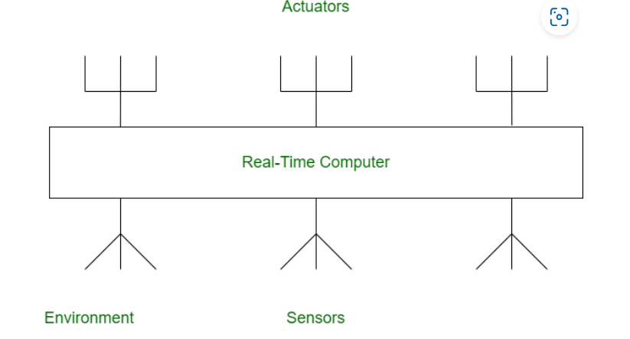
Structure of Embedded Real-time System

Slide 6
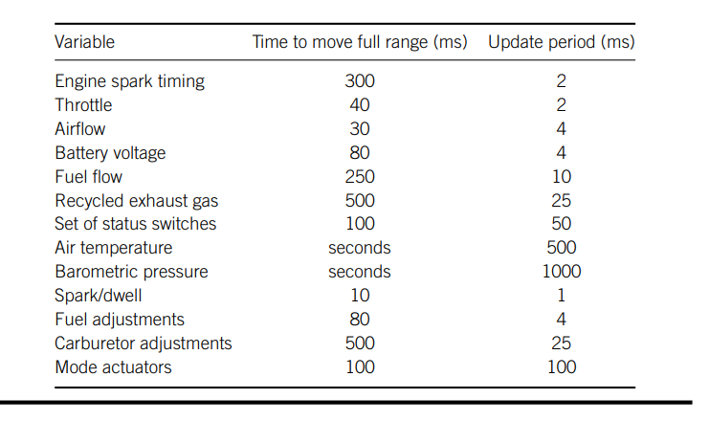
ENGINE SPECIFICATION

Slide 7
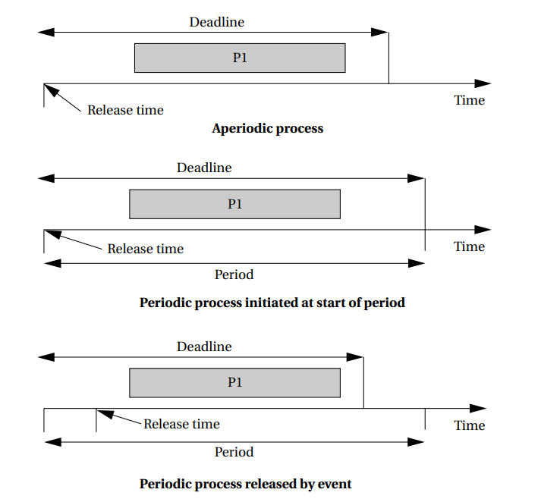
EVENT PROCESS

Slide 8
Real-Time Embedded Systems
Real time system is defined as a system in which job has deadline, job has to finished by the deadline (strictly finished). If a result is delayed, huge loss may happen.
A real-time operating system (RTOS) is a type of operating system that is designed to meet strict time constraints, with a guaranteed response time for critical tasks.
An example of an RTOS is the Free RTOS, which is widely used in embedded systems, IoT devices, and industrial control systems.
Free RTOS provides a set of real-time kernel services, such as task management, inter-task communication, and time management, to help developers create reliable and deterministic real-time applications

Slide 9
Real-Time Systems
The structure of a real-time system is a controlling system and at least one controlled system
Controlling
System
input
output
Controlled
System
Controlled
System
Controlled
System
output
input

Slide 10
REAL TIME SYSTEM TYPES
Hard Real Time System
Soft Real Time System:

Slide 11
Hard real time
Hard real time is a system whose operation is incorrect when result is not produce according to time constraint.
In hard real-time systems, timing constraints are extremely strict and failure to meet a deadline can have serious consequences, such as human injury or equipment damage. These systems typically require deterministic and predictable behavior, with a guaranteed response time for critical tasks. Examples include medical equipment, military defense systems, and industrial control systems.
1. Air Traffic Control
2. Medical System

Slide 12
Hard Real-Time System
Degree of tolerance of missed deadline
Extremely small or zero
Usefulness of computed results after missed deadlines
Likely useless
Severity of the penalty incurred for failing to meet deadlines
catastrophe

Slide 13

Hard Real-Time System

Slide 14
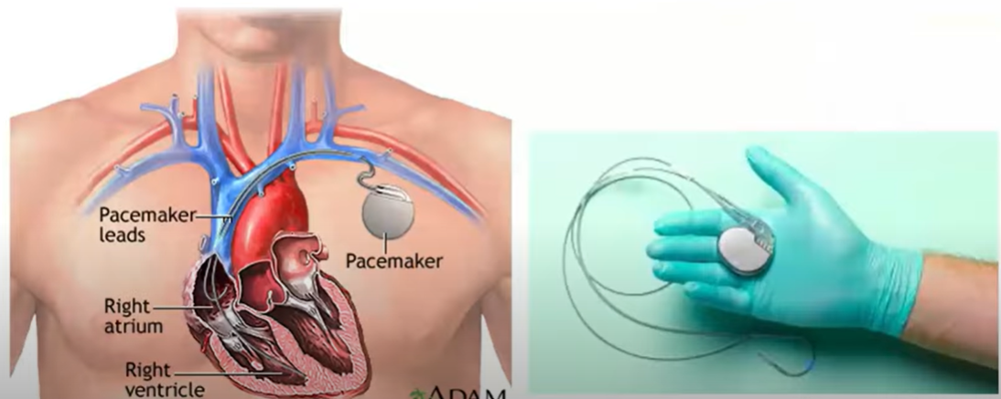
Hard Real-Time System

Slide 15
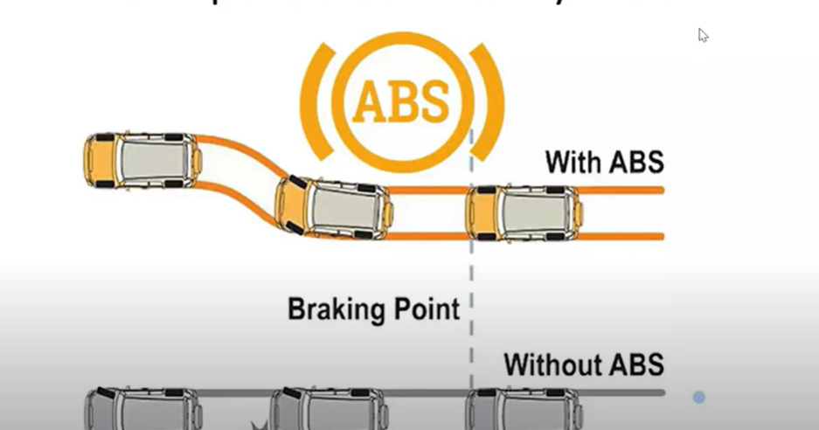
HArd Real-Time System

Slide 16

Hard Real-Time System

Slide 17
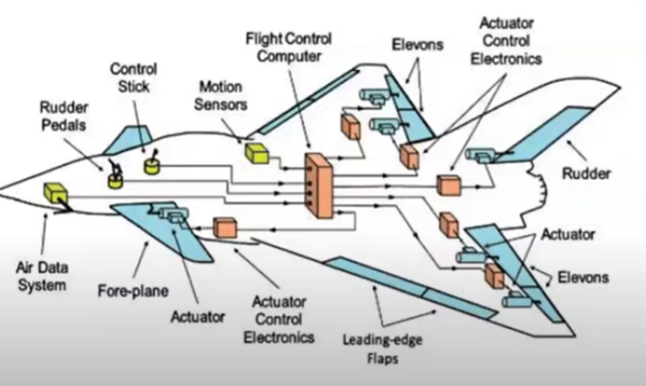

Slide 18
Soft real time system
Soft real time system is a system whose operation is degrade if results are not produce according to the specified timing requirement.
For example,
1. Multimedia Transmission and Reception
2. Computer Games
3. Communication system like voice over Ip

Slide 19

Soft Real-Time System

Slide 20

Soft Real-Time System

Slide 21
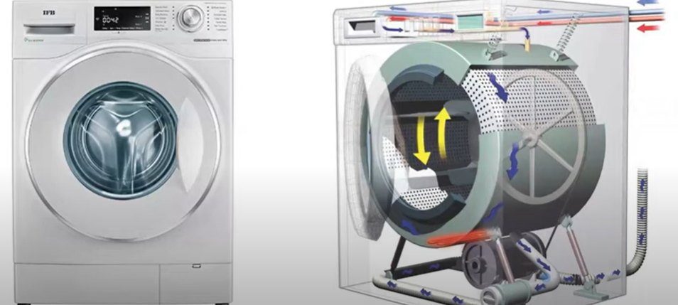
Soft Real-Time System

Slide 22
HARD REAL TIME SYSTEM | SOFT REAL TIME SYSTEM
In hard real time system, the size of data file is small or medium. | In soft real time system, the size of data file is large.
In this system response time is in millisecond. | In this system response time are higher.
Peak load performance should be predictable. | In soft real time system, peak load can be tolerated.
In this system safety is critical. | In this system safety is not critical.
A hard real time system is very restrictive. | A Soft real time system is less restrictive.
In case of an error in a hard real time system, the computation is rolled back. | In case of an soft real time system, computation is rolled back to previously established a checkpoint.
Satellite launch, Railway signaling system etc. | DVD player, telephone switches, electronic games etc.
Guarantees response within a specific deadline. | Does not guarantee response within a specific deadline.
Catastrophic or severe consequences (e.g., loss of life or property damage). | Minor consequences (e.g., degraded performance or reduced quality).
Focused on processing critical tasks with high priority. | Focused on processing tasks with lower priority.
Highly predictable, with well-defined and deterministic behavior. | Less predictable, with behavior that may vary depending on system load or conditions.

Slide 23
Comparison
Value
Deadline
Soft RTS
Hard RTS
Time
Notes:
This is the comparison of hard and soft real-time systems.
X-axis denotes the time while Y-axis denotes the value.
For hard RTS, once missing deadline, the system’s value is negative, which means the system is damaged. In contrast, in a soft RTS, the value is still positive after missing deadline. However, if the finish time is far behind deadline, the value would also become negative.

Slide 24
Job versus Task
Job: unit of work that is scheduled and executed by the system
Computation of a FFT (Fast Fourier Transform)
Transmission of a data packet
Task: a set of related jobs which jointly provide some system function
Notes:
We assume that system activation entities consists of Job and Task.
Job denotes a set of execution flow while Tasks denotes a set of related jobs that cooperate to provide a specific system function.

Slide 25
Release Time and Deadlines
Release time
the instant of time at which the job becomes available for execution
Jobs have no release time if all the jobs are released when the system begins execution
Response time
The length of time from the release time of the job to the instant when it completes
Notes:
This and following slides shows the job’s timing characteristics, including release time, response time, relative deadlines and (absolute deadline)

Slide 26
Release Time and Deadlines (Cont.)
Relative deadline
The maximum allowable response time of a job
Deadline or Absolute Deadline
The instant of time by which its execution is required to be completed
Equal to the release time plus the relative deadline
A job has no deadline if its deadline is at infinity

Slide 27
Feasibility
Timing Constraints
A constraints imposed on the timing behavior of a job
Specified in terms of
Release time
Relative deadline or absolute deadline
The set of rules that determines the order in which tasks are executed is called a scheduling algorithm
A schedule is feasible if all tasks can be completed according to the timing constraints
A set of tasks is schedulable if there exists at least one algorithm that can produce a feasible schedule

Slide 28
Type of Tasks
A Periodic task is executed repeatly at regular time intervals, and each invocation is called a job or instance.
Often time-driven
A Aperiodic task is executed to response to external events, and to respond, it executes aperiodic jobs whose release time are not known prior.
Often event-driven
Off-line guarantee of aperiodic tasks must make proper assumptions on the environments; that is, by assuming a maximum arrival rate for each event (i.e., minimum interarrival time)
Aperiodic tasks characterized by a minimum interarrival time are called sporadic tasks
Notes:
According to the regularity of task’s activation, we divide the tasks into two sets: on is the periodic task and the other is the aperiodic task.
Periodic tasks are regularly activated at a constant rate. Each invocation activity is called a job or an instance.
In contrast, the invocation of aperiodic tasks are not regular and undetermined. Thus, it is often event-driven.
Notably, since the uncertainly of tasks’ invocations, to off-line guarantee of aperiodic tasks’ execution, we may assume a maximum arrival rate for each event. A aperiodic task that is characterized by a minimum interval time is called a sporadic task.

Slide 29
Classification of Scheduling Algorithm
Preemptive/Nonpreemptive
Preemptive: the running tasks can be interrupted to assign the processor to another task
Non-preemptive: A task, once started, is executed until completion.
Static/Dynamic
Static: the scheduling decisions are based on fixed parameters and assigned to tasks before their activation
Dynamic: the scheduling decisions are based on dynamic parameters that may change during system evolution
Notes:
The scheduling algorithms can be classified as
Preemptive or nonpreemptive
Static or dynamic
Off-line or on-line
Optimal or heuristic
Dynamic or fixed

Slide 30
Classification of Scheduling Algorithm (Cont.)
Off-line/On-line
Off-line: a scheduling algorithm is executed on the entire task set before actual task activation. The schedule may be stored in a table and later executed by a dispatcher
On-line: scheduling decisions are taken at runtime every time a new task enter the system or when a running task terminates

Slide 31
Classification of Scheduling Algorithm (Cont.)
Optimal/Heuristic
Optimal: an algorithm is optimal if it minimizes some given cost function defined over the task set.
Heuristic: an algorithm is heuristic if it tends toward but does not guarantee to find the optimal schedule
Dynamic/Fixed
Fixed: in which the priority of each process is fixed for any instantiation
Dynamic: priority changes

Slide 32
Metrics for Performance Evaluation
Metrics for hard real-time system
Schedulability
Optimality, etc.
Metrics for soft real-time system
Miss ratio
Response time, etc.
Other metrics
Completion time
Jitter, etc.
Combination of metrics
Notes:
To evaluate a hard real-time system, the metrics may be schedulability, optimality etc.
In contrast, to evaluate a soft real-time system, the metrics may be miss ratio, response time, etc.
Other metrics, including the completion time, jitter, may also be applied in the evaluation of a hard or soft real-time system

Slide 33
Commonly Used Approaches to Real-Time Scheduling
Clock-Driven
Priority-Driven
Notes:
The approaches to implement a real-time scheduling algorithm, depending on its characteristics, may be clock-driven or priority-driven.

Slide 34
Clock-Driven Approach
Also called time-driven
Because each scheduling decision is make at a specific time, independent of events, such as job releases or completions, in the system
Applicable only when the system is deterministic, except for a few aperiodic jobs
The parameters of all periodic tasks are known a priori
Therefore, the scheduler is often constructed by a static schedule of the jobs off-line
Use a hardware timer to trigger the scheduling decision
Notes:
Clock-driven approach is also called time-driven. To adopt the clock-driven approach, the system must be deterministic. For example, the scheduling algorithm for periodic tasks may use the clock-driven approach since their parameters are know a priori. As a result, the scheduler often constructed by a static schedule off time.

Slide 35
Priority-Driven Approach
Scheduling decisions are made when events, such as release and completions of job occurs
Therefore, priority-driven algorithms are event-driven
Many non-real-time scheduling algorithms are priority-driven
FIFO (First-In-First-Out)
Assign priority according to the release time
SETF (Shortest-Execution-Time-First)
Assign priority on the basis of job execution times
Notes:
Priority-driven approach assigns each task a different priority and schedules tasks on the basis of their priority.
To assign a task’s priority, we may choose a task’s real-time or deadlines to determine its priority. Thus, priority-driven algorithms are event-driven and the event are tasks’ priority.
Some well-known priority-driven algorithms are FIFO and SETF.

Slide 36
Priority-Driven Approach (Cont.)
Priority-driven real-time scheduling algorithms
Dynamic-priority
e.g. EDF (Earliest Deadline First)
Fixed-priority
e.g. RM (Rate Monotonic)
Notes:
For real-time systems, depending on whether dynamic or fixed or not, the priority-driven approaches may be dynamic-priority or fixed-priority.
The well-known EDF algorithm is a dynamic-priority driven algorithm. In contrast the RM is a fixed-priority driven algorithm

